Slide 1
How to bait a hook with Dirt
A Study of The appeal of celebrity gossip
By Julie Martin

Slide 2
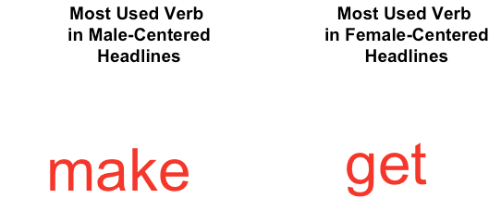

Slide 3
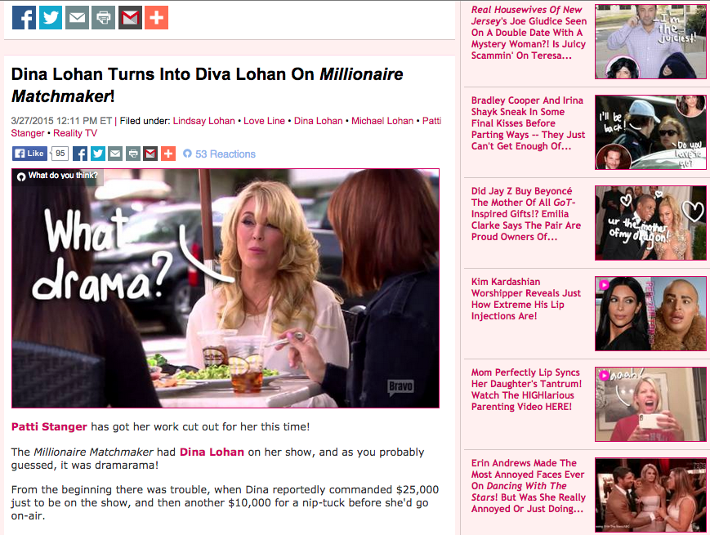
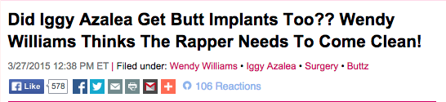
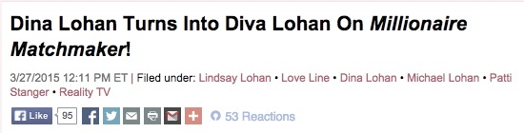
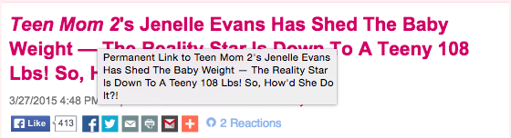
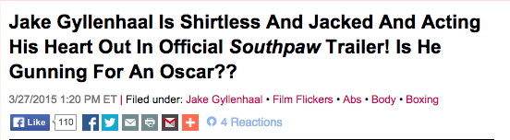
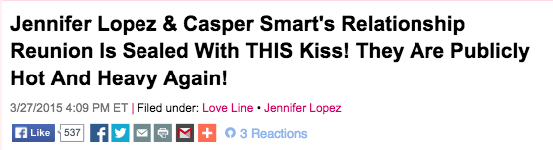
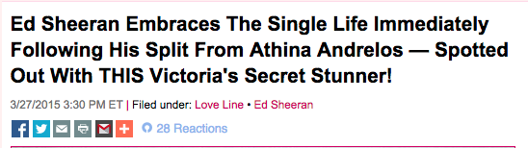

Slide 4
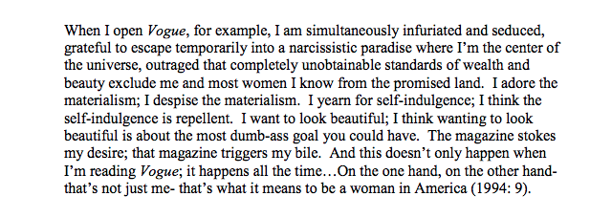
The experience
-

Slide 5
The Data
352 observations of 7 variables
Dates between March 25th – 31st, 2015.
For the most part, using manual data collection methods
- Could leave room for potential biases
Alternative R text mining packages:
‘treetag’ command in koRpus: ‘tags’ each word with its part of speech

Slide 6
Discussion of variables
Headline: plain text of the blog post title
- stripped of punctuation, unnecessary spaces, capitalizations using the ‘clean.text’ function given in class

Slide 7
Discussion of Variables
Number of Facebook Likes per blog post
- taken as an instrumental variable to quantify ‘popularity’ of the post
- Potential problems:
- When someone ‘likes’ a post, they’ve likely read the entire post, not just the headline.
- People might not ‘like’ posts that they find interesting, but don’t agree with the message.
→ Skew
- Underestimating the catchiness of the post

Slide 8
Discussion of Variables
Main Verbs: the main verbs in the blog post title
‘cleaned’ the verbs to be in root form for easy tally of frequency counts
ex. ‘to be’ instead of ‘is
Passive voice verbs: include the root verb and its passive supplementary verb
ex. ‘get dumped’ recorded as ‘get’ ‘dump’
→ Therefore, R treats these verbs as separate.
Pro: ability to analyze use of passive/active voice in male/female-centered posts
Con: doesn’t allow for analysis of verb phrases

Slide 9
Discussion of Variables
Gender: the gender of the celebrity mentioned in the title
- not necessarily the grammatical subject
- if multiple celebrities mentioned, take the gender of the first one
Why?
‘Catchiness’ is likely due to interest in the celebrity.
Again, when skimming through headlines fast, ‘catchiness’ of first celebrity matters more than others.

Slide 10
Discussion of variables
Active.role: a dummy variable for whether the celebrity played an active (1) or passive (role) in the headline
Assumptions and Personal Biases
I don’t consider ‘to be’ an active verb
Discussion of ‘pseudo-active’ verbs (show, display, wear etc.)
If the celebrity is the subject of a sentence whose main verb is in the passive voice, I don’t consider them to be playing an active role.

Slide 11
Discussion of variables
Career.related: a dummy variable for whether the topic of the post (as defined only by the title) is related to the relevant celebrity’s career (1) or not (0).
Assumptions and Personal Biases
I didn’t consider appearances on TV shows as career-related unless they were interviews.
Potential issues: TV appearances are often important tools for gaining publicity, which may be considered career-related.

Slide 12
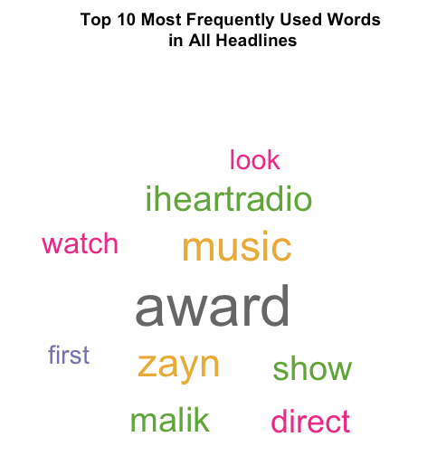
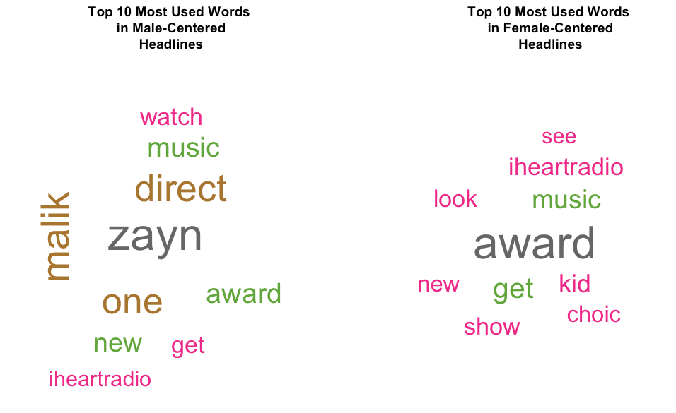
Clear time period-related biases in sample of all words
Result of non-random sampling
(only blog plots from March 25th - 31st, 2015)
How to fix this?

Slide 13
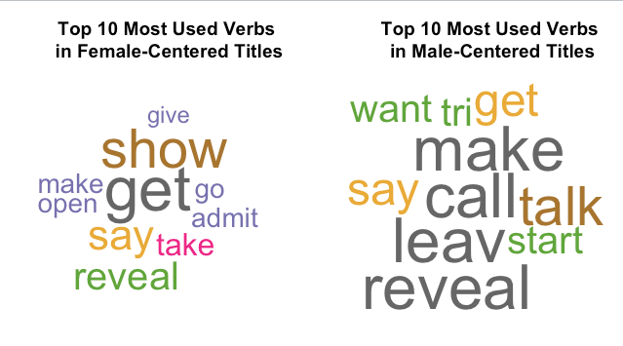
Used verbs instead!
Why?
Trying to get a rough sentiment analysis of language use according to gender. So, names and proper nouns aren’t relevant.
Writer has more leeway in choosing verbs than nouns

Slide 14
Comparisons
- ‘show’: again, frequent use of ‘pseudo-active verbs for females but not males’
Use of ‘say’ vs. ‘talk’
‘talk to’ or ‘talk about’ vs. ‘say “something”’

Slide 15
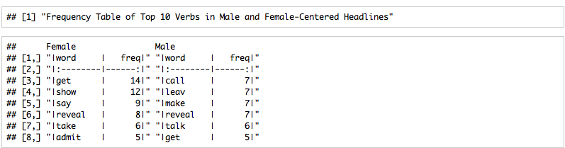
Top Verbs by Gender

Slide 16
WhY?
Verbs like ‘show’, ‘display’, and ‘reveal’ used primarily in the context of a (generally female) person’s hair/clothes/body
Used so frequently that I decided not to count them as active verbs
Why were these words catchy?
Anna McDonnell cites second wave feminism’s slogan: ‘The personal is political’.
- Celebrity gossip gives women a space to discuss personal insecurities and issues not talked about in ‘mainstream’ news sources.
But also, these verbs make the political, personal.
- words like ‘show’ and ‘reveal’ connote a type of exclusivity and intimacy between the reader and celebrity subject

Slide 17
Acknowledgements
Screenshots on Slide 3 courtesy of Perezhilton.com.
Quote on Slide 4 courtesy of Andrea McDonnell’s dissertation, “Just Like Us: Celebrity Gossip Magazines in American Popular Culture.”
Reference on Slide 16 to Andrea McDonnell and her ideas expressed in her dissertation, “Just Like Us: Celebrity Gossip Magazines in American Popular Culture.”

